Slide 1
Getting Started with BI
Stan Bice

Slide 2
About Stan Bice
Senior Data Warehouse Developer, PANDORA Jewelry
Over 20 years of software development experience
Past 8 years focused on database, data warehouse and business intelligence development
Spoken at user groups and code camps, and participated in give camps
Technical reviewer with Manning Press
MCITP Business Intelligence Developer 2008
40% Complete - MCSE Data Platform (SQL Server 2012/2014)
LinkedIn and Twitter (@StanBice3)

Slide 3
GitHub
https://github.com/stanbice

Slide 4
SQL Server 2016
How to download SQL Server 2016 Developer Edition for free:
http://biinsight.com/how-to-download-sql-server-2016-developer-edition-for-free/
SQL Server Samples
https://github.com/Microsoft/sql-server-samples

Slide 5
Definition

Slide 6
Business Intelligence
Business intelligence (BI) is an umbrella term that includes the applications, infrastructure and tools, and best practices that enable access to and analysis of information to improve and optimize decisions and performance.
http://www.gartner.com/it-glossary/business-intelligence-bi/

Slide 7
A Little History…

Slide 8
Components

Slide 9
Components of a BI Solution
Data Sources
ETL
Data Warehouse
Analytical Processing
Reporting
Throughout the entire solution, the design is very important!

Slide 10
Data Sources
CSV and TSV files
XML files
Databases (SQL and NoSQL)
Web Services and Web API’s (JSON)

Slide 11
ETL
Extract
Retrieve the data from the source systems
Transform
Perform cleansing, mapping, calculations and other data manipulations
Load
Write to the data warehouse

Slide 12
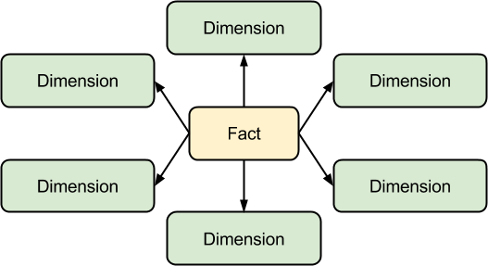
Data Warehouse
Relational database that is loaded during an ETL process
Using a dimensional model
Star or Snowflake data model
Facts relating to Dimensions
https://knowledgebase.monexa.com/Monexa_Billing
/Monexa_System_Knowledge/Inside_Monexa's_Data_Warehouse_Design

Slide 13
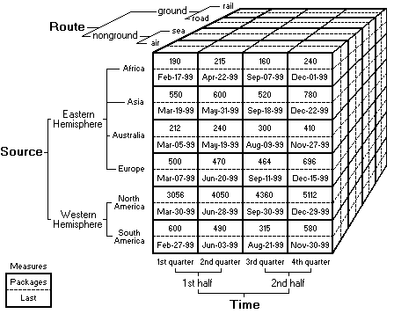
Analytical Processing
The data warehouse data is compiled, performing calculations and aggregations, to be used for analysis and reporting
Options:
SSAS Multidimensional
SSAS Tabular
QlikView
Tableau
Power BI
https://technet.microsoft.com/en-us/library/aa216365(v=sql.80).aspx

Slide 14
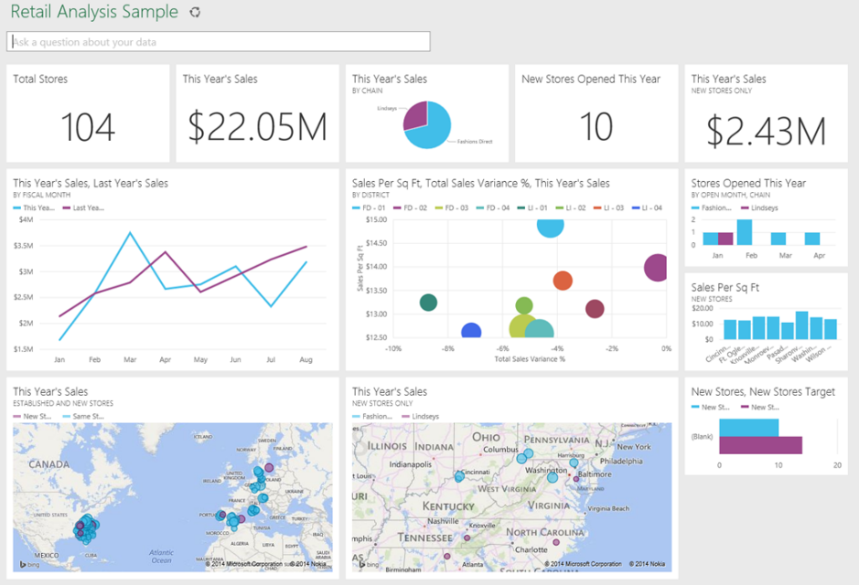
Reporting
Operational Reporting
Dashboards
Key Performance Indicators (KPI)
Analytical
“How well are we doing now, compared to then?”
“How well did Widget A sell here versus there?”
“Is the team/person doing better or worse?”
http://sqlblog.com/blogs/marco_russo/archive/2014/12/18
/the-power-bi-dashboard-in-public-preview-available-also-without-office.aspx

Slide 15
Terminology

Slide 16
Facts and Dimensions
Basic entities in a Data Warehouse
Dimension
Objects that contain attributes that describe events (facts) that occurred
Customer – Number, Name, Region, State
Product – Number, Category
Fact
Contains the data of an event that occurred
Sales – Date, Customer, Product, Retail Price, Wholesale Price

Slide 17
Facts and Dimensions
DimCustomer
CustomerKey
CustomerNumber
State
Zip
…
FactSales
SalesKey
CustomerKey
DateKey
TransactionNum
ProductKey
Quantity
Price
…
DimDate
DateKey
Year
Month
Day
…
DimProduct
ProductKey
ProductNumber
ProductName
…

Slide 18
Granularity
Specifies the level of the data that is stored, for each record
Transactions by Customer, including Date and Product
Transactions by Customer, totaled by Date
All of the fact table records should be on the same level of granularity
Each fact table can be on its own level of granularity
Users need to understand granularity, for querying
Granularity may be dictated by the source data

Slide 19
Granularity
DimCustomer
CustomerKey
CustomerNumber
State
Zip
…
FactSales
FactMonthlyBudget
SalesKey
CustomerKey
DateKey
TransactionNum
ProductKey
Quantity
Price
…
MonthlyBudgetKey
CustomerKey
DateKey
Quantity
Price
…
DimDate
DateKey
Year
Month
Day
…
DimProduct
ProductKey
ProductNumber
ProductName
…

Slide 20
Type I and Type II Dimensions
Determines the impact of changes to dimension and fact data records
Type I Dimension
When the dimension data record is updated, all fact history is updated
Type II Dimension
When the dimension data record is updated, a new dimension data record is created
Fact history is not impacted
Changes are tracked by including data record start and end dates
Future fact data records will be associated with the new dimension data record

Slide 21
Type I Dimension Update Example
CustomerKey | Name | State
1 | Bice, Stan | MD
2 | Barley, Ray | MD
- Stan moves to Florida

Slide 22
Type I Dimension Update Example
CustomerKey | Name | State
1 | Bice, Stan | FL
2 | Barley, Ray | MD
- All of Stan’s sales history now say they were shipped to Florida

Slide 23
Type II Dimension Update Example
CustomerKey | Name | State | StartDate | EndDate
1 | Bice, Stan | MD | 01/01/2016 | 12/31/9999
2 | Barley, Ray | MD | 01/01/2016 | 12/31/9999
- Stan moves to Florida on 2/14/2016

Slide 24
Type II Dimension Update Example
CustomerKey | Name | State | StartDate | EndDate
1 | Bice, Stan | MD | 01/01/2016 | 02/14/2016
2 | Barley, Ray | MD | 01/01/2016 | 12/31/9999
3 | Bice, Stan | FL | 02/14/2016 | 12/31/9999
- All of Stan’s sales on and after 2/14/2016 will say they were shipped to Florida

Slide 25
Late Arriving Dimension
Pertains to when the dimension record is retrieved
Late Arriving Dimension
The dimension record is received after the fact record
http://www.kimballgroup.com/data-warehouse-business-intelligence-resources/kimball-techniques/dimensional-modeling-techniques/late-arriving-dimension/

Slide 26
Early/Late Arriving Fact
Pertains to when the fact record is retrieved
Early Arriving Fact (same as Late Arriving Dimension)
The fact record is received before the dimension record has been created
Causes issues when the fact needs to lookup the associated dimension record
Late Arriving Facts
The fact record is received after the date that the transaction occurred

Slide 27
Tools

Slide 28
Tools for Building a BI Solution
Power BI
Initially an Excel Add-In, now a desktop app
DAX expressions used for calculations
Can extract, transform and present the data

Slide 29
Tools for Building a BI Solution
SSAS Tabular
Part of SQL Server
DAX or MDX expressions used for calculations
Can upgrade a Power BI model to create an SSAS Tabular project

Slide 30
Tools for Building a BI Solution
SSAS Multidimensional
Part of SQL Server
Creates a cube
MDX expressions used for calculations

Slide 31
Tools for Building a BI Solution
SSIS
Part of SQL Server
Used to create the ETL
Builds the Data Warehouse

Slide 32
Tools for Building a BI Solution
SSRS
Part of SQL Server
Presentation of the data
Received a major update in SQL Server 2016
Excel
Used for pivot tables
Can only connect to one data source (i.e. cube) at a time

Slide 33
Walkthrough

Slide 34
Evolution

Slide 35
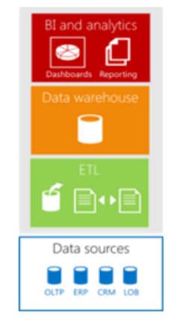
Traditional Data Warehouse
http://download.microsoft.com/download/C/2/D/C2D2D5FA-768A-49AD-8957-1A434C6C8126/
The_Microsoft_Modern_Data_Warehouse_White_Paper.pdf

Slide 36
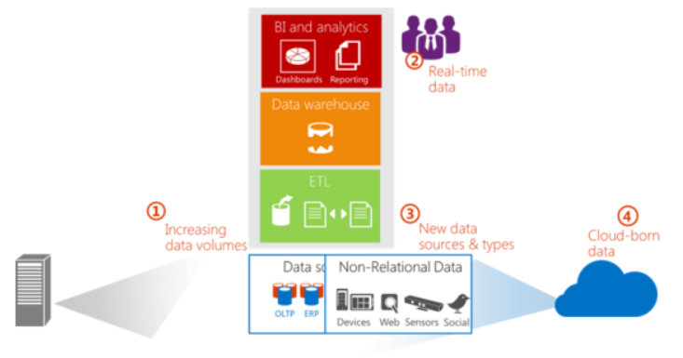
Modern Data Warehouse
http://download.microsoft.com/download/C/2/D/C2D2D5FA-768A-49AD-8957-1A434C6C8126/
The_Microsoft_Modern_Data_Warehouse_White_Paper.pdf

Slide 37
Questions

